Slide 1
Multiprocessor and Multicomputer
multiprocessor is a system with two or more CPUs that is capable of performing multiple tasks at the same time while a multicomputer is a system with multiple processors that are connected via an interconnection network to perform a computation task.

Slide 2
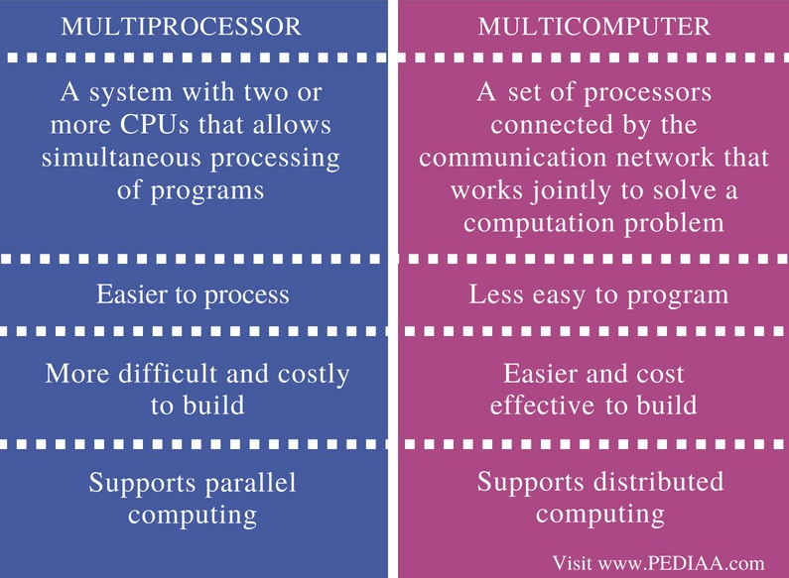

Slide 3
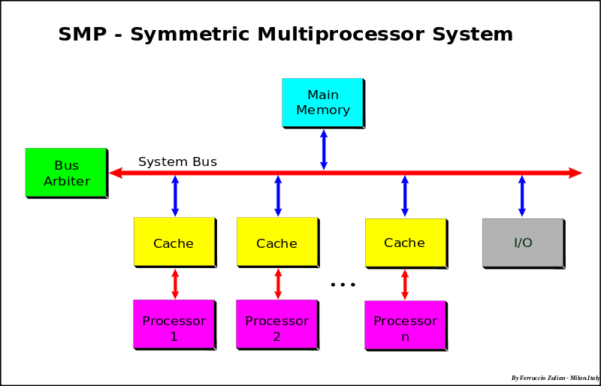

Slide 4
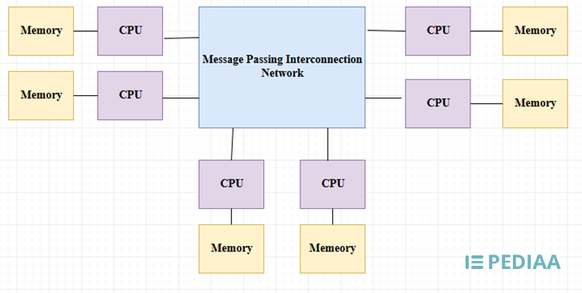

Slide 5
The difference between multiprocessor and multicomputer is that
the multiprocessor is a system with two or more CPU that is capable of performing multiple tasks at the same time
while a multicomputer is a system with multiple processors that are connected via an interconnection network to perform a computation task.

